Slide 1
SPIKING NEURAL NETWORKS FOR FAST-MOVING OBJECT DETECTION
Mario Real Enrique

Slide 2
Problem Statement
Conventional cameras either introduce huge latencies or generate too much data
Problem for real-time ball trajectory prediction
We want to leverage event cameras and SNNs to extract the relevant information for the vision system of the goalkeeper (RoboCup).
2 pieces:
Data
Model

Slide 3

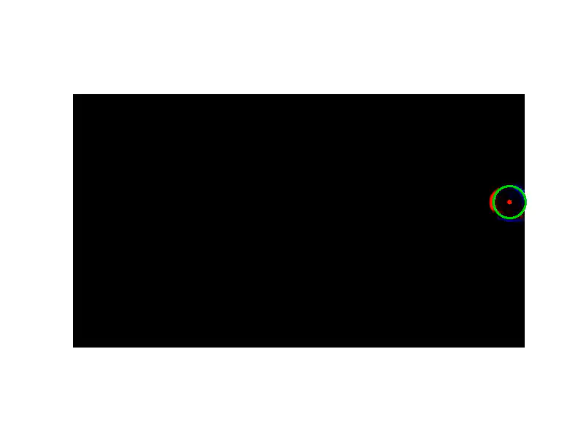
Data
Real event data of ball throws
Positive and negative events
Labeled using OpenCV
Data and labels get reduced by a factor of 2 for reduced training times

Slide 4
Initial Approach
X SFCL
Argmax()
X prediction
Ball detector on images
Input: Positive and negative events (2 channels) accumulated during 10ms
Output: X,Y pixel prediction of the ball on the image.
Motivation
Easier problem
Initial estimation of accuracy, training times and latency
EVENT DATA
2 channels
(+, -)
3 Layer SCNN
Y SFCL
Argmax()
Y prediction

Slide 5
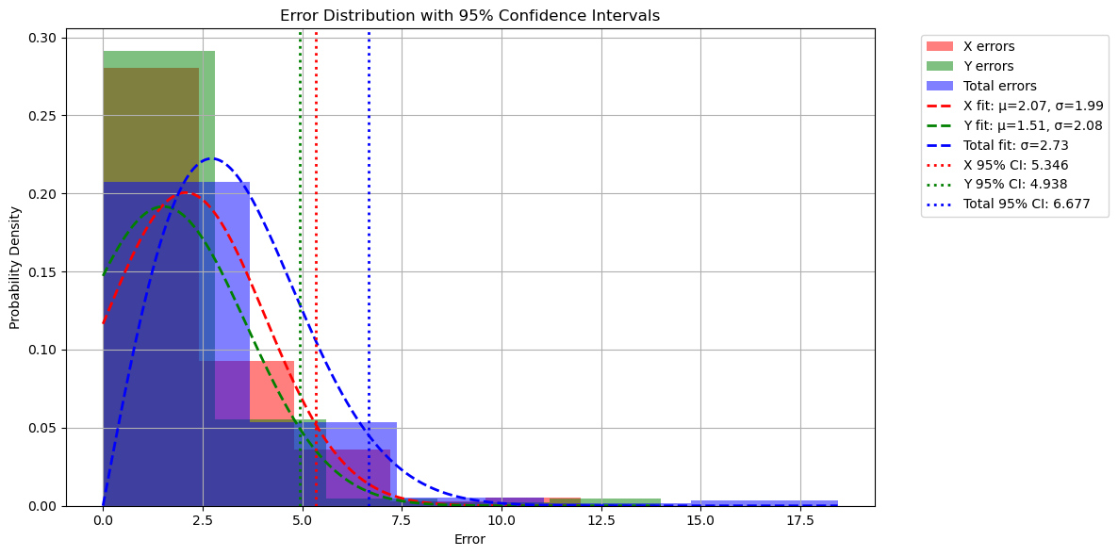
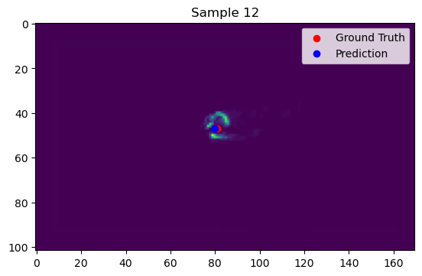
Training
Images were shuffled
Each image was shown to the SNN for 20 time steps
Trained for 50 epochs
Results
Training time: 3h 40 min
Inference time: 40ms
Avg error: 5,13 px
95% CI error: 13,36 px
Original image 680x408

Slide 6
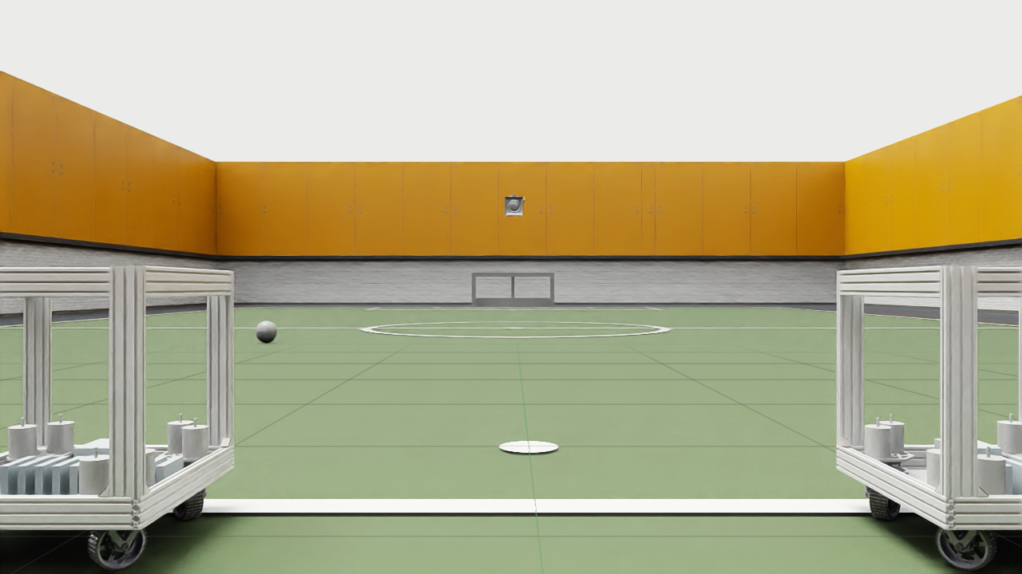
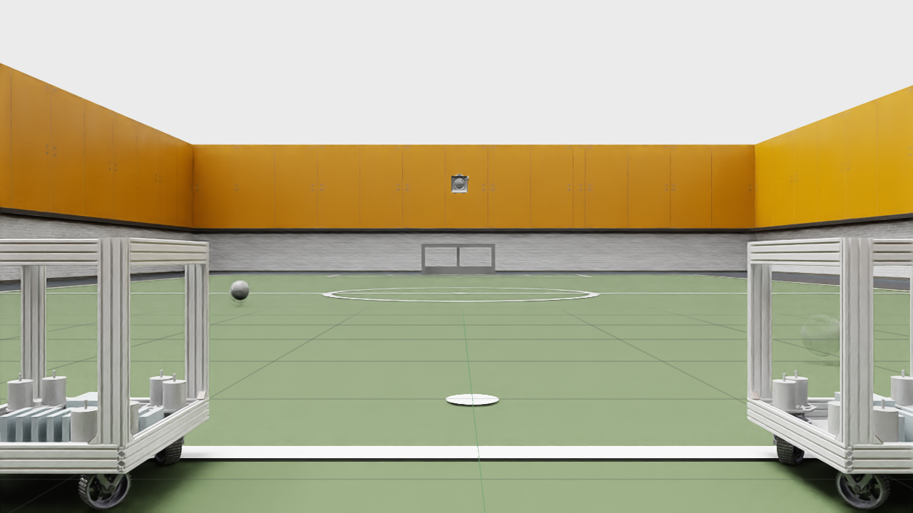
Next steps:
Simulated data with IsaacSIM
Better labels
More diverse data
Problems encountered:
“Shadow” when moving the ball
Difficulty setting up the camera parameters

Slide 7
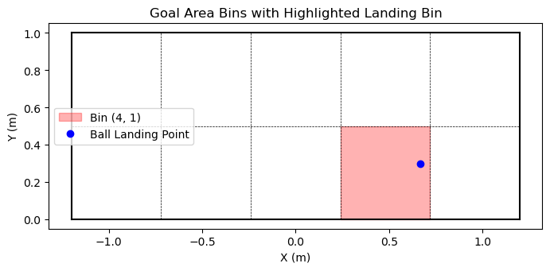
Next steps
Video to event data
Implement locally
ESim, Vid2E, V2E
Approaches
Dual camera ball tracker
Ball tracker + radius estimation
Goal hit point predictor
Decreasing inference time

Slide 8
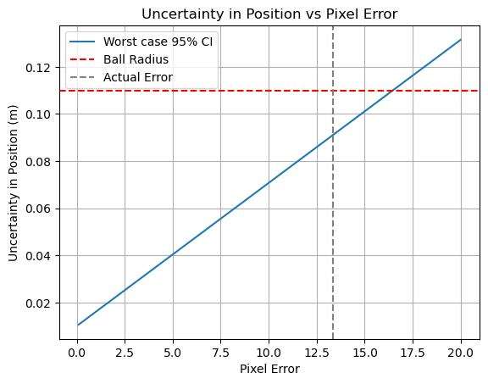
Uncertainty estimation: naive approach
Worst case scenario
Ball moving at 10 m/s at 10 m from the camera
95 percentile worst pixel error (13,36 px)
Time interval between collections of events: 1ms
Two components
1 pixel in the real world * error in pixels
Velocity * time interval

Slide 9
Uncertainty estimation: formal approach
The idea is to propagate the 3D position uncertainty in time for trajectory estimation
The resulting position uncertainty should be less than half the size of the robot
This would serve as a higher bound for the error in the classification task
A Kalman Filter would be needed for calculating the uncertainty of the velocity

Slide 10
Questions
What is the expected uncertainty for the position of the robot and its orientation?
What do you think about the formal approach for uncertainty estimation?
Do the proposed approaches satisfy the needs of the team?

